Slide 1
What You Need to Know about Financial Aid

Slide 2
Sponsors/Partners:
Jefferson Parish Employee's Federal Credit Union
Sam’s Club
9598 Cortana Place
Baton Rouge, LA
Presenters:
Notes:
This session is sponsored by__________________________________
__________________________________________________________
______________.
My name is _______________________________
And I am from ___________________________ College/University.
Joining me today are my colleagues _________________________ from
____________________________. (introduce all volunteers).
Today’s event is also made possible through the
cooperation of the wonderful staff here at _______________ (location).

Slide 3
Topics We Will Discuss
What is financial aid
Cost of attendance (COA)
Expected Family Contribution (EFC)
What is financial need
Categories, types, and sources of financial aid
Free Application for Federal Student Aid (FAFSA)
Special circumstances

Slide 4
What is Financial Aid?
Financial aid consists of funds provided to students and families to help pay for postsecondary educational expenses

Slide 5
What is Cost of Attendance (COA)
Direct costs
Indirect costs
Direct and indirect costs combined into cost of attendance
Varies widely from college to college

Slide 6
What is the Expected Family Contribution (EFC)
Amount family can reasonably be expected to contribute
Stays the same regardless of college
Two components
Parent contribution
Student contribution
Calculated using data from a federal application form and a federal formula

Slide 7
What is Financial Need
Cost of Attendance
– Expected Family Contribution
= Financial Need

Slide 8
Categories of Financial Aid
Need-based
Non-need-based

Slide 9
Types of Financial Aid
Scholarships
Grants
Loans
Employment

Slide 10
Scholarships
Money that does not have to be paid back
Awarded on the basis of merit, skill, or unique characteristic

Slide 11
Grants
Money that does not have to be paid back
Usually awarded on the basis of financial need

Slide 12
Loans
Money students and parents borrow to help pay college expenses
Repayment usually begins after education is finished
Only borrow what is really needed
Look at loans as an investment in the future

Slide 13
Employment
Allows student to earn money to help pay educational costs
A paycheck; or
Non-monetary compensation, such as room and board

Slide 14
Sources of Financial Aid
Federal government
States
Private sources
Civic organizations and churches
Employers

Slide 15
Louisiana State Aid
• Taylor Opportunity Program for Students (TOPS)
TOPS Tech
Early Start Program
TOPS Tech Early Start
Go Grant
Rockefeller State Wildlife Scholarship
START Saving Program
State Matching Funds Grant
John R. Justice Program
LOSFA administered Federal Program: Chafee Educational Training Voucher (ETV) Program
Notes:
Almost all 50 states have some form of special grant or loan aid for their state residents.
Some states use the data the student provides on the Free Application for Federal Student Aid (FAFSA) to award their aid.
Others states may require the student to submit supplemental forms that are processed directly by the state’s higher education agency
The student’s school counselor should have the correct form(s) for the state’s application. If the forms are not available at the school, contact the state higher education agency directly, or search for them on-line.

Slide 16
TOPS: Application
Two methods for applying for TOPS:
FAFSA (Free Application for Federal Student Aid) – www.fafsa.ed.gov
Preferred application
Must be completed if the student is eligible for federal grant aid (Pell Grant)
Must be completed if the student is seeking any other form of financial aid
The only application needed for TOPS
TOPS Online Application – www.osfa.la.gov
May only be completed by students who can certify that they do not qualify for federal grant aid
In the event of a budget shortfall, students completing the TOPS Online Application will be the first to lose their TOPS award
Do not complete if you have completed the FAFSA
Notes:
Let’s talk about (your state) aid programs.
Note to presenters: If your state has one or more state aid programs, describe at this point in the presentation.

Slide 17
TOPS: Application Deadlines 2012 Graduates
Initial Application Receipt Date | Receives TOPS funding for:
Jan. 1, 2012 – July 1, 2013 | 8 semesters (12 quarters) Beginning Fall 2012
July 2, 2013 – Aug. 29, 2013 | 7 semesters (10 quarters) Beginning Fall 2012
Aug. 30, 2013 – Oct. 29, 2013 | 6 semesters (9 quarters) Beginning Fall 2012
Initial Applications Received After October 29, 2013 | Ineligible for TOPS
Students who attend the 2012-2013 academic year who apply for TOPS between July 2, 2012 and October 29, 2013 must also have met the TOPS retention requirements to be eligible for TOPS funding at the beginning in the Fall 2013 semester.
Notes:
Let’s talk about (your state) aid programs.
Note to presenters: If your state has one or more state aid programs, describe at this point in the presentation.

Slide 18
TOPS: Processing Cycle
LOSFA receives ACT or SAT scores electronically. Students should include LOSFA’s TOPS code on their test registration (ACT:1595, SAT: 9019)
LOSFA receives transcript data from the Louisiana Department of Education after high school graduation
LOSFA receives information from the FAFSA or TOPS Online Application
Once all required data is received, TOPS eligibility is determined
Students can also check their award status on the LA Award System located on www.osfa.la.gov
Colleges have access to Master List of TOPS eligible students
Notes:
Let’s talk about (your state) aid programs.
Note to presenters: If your state has one or more state aid programs, describe at this point in the presentation.

Slide 19
TOPS: Eligibility
For TOPS standard eligibility and renewal requirements consult LOSFA Web site:
www.osfa.la.gov
1-800-259-5626 x1012
custserv@osfa.la.gov
Notes:
Let’s talk about (your state) aid programs.
Note to presenters: If your state has one or more state aid programs, describe at this point in the presentation.

Slide 20
Louisiana Connect
The Louisiana Office of Student Financial Assistance (LOSFA) is pleased to announce the launch of Louisiana Connect, a comprehensive, college & career planning web portal available to all 8th - 12th grade students in the State of Louisiana.

Slide 21
Louisiana Connect – Students
STUDENTS: With Louisiana Connect You Can:
Connect with colleges and universities that are a match for you
Learn about careers and connect with employers
Find scholarships and other programs designed to help you succeed
Stay Connected with Your Communication Center
Access Your Exclusive News Feed and Event Planner
Build Your Profile. Show Off Your Skills and Achievements
You Can Afford a College Education…Learn How

Slide 22
Louisiana Connect - Parents
PARENTS: With Louisiana Connect You Can:
Track student progress against important college and career planning activities
Search for colleges, compare costs and make recommendations to students
Search for scholarships and make recommendations to students
View your child’s Individual Graduation Plan (IGP)
View your child’s career plan and explore occupation profiles
Learn about college costs, need-based aid and other financial options
Access your personal Communication Center where you can communicate with your child and receive important messages, alerts and event invitations

Slide 23
www.louisianaconnect.org

Slide 24
Select “I am a Parent”

Slide 25
Enter your Child’s information

Slide 26
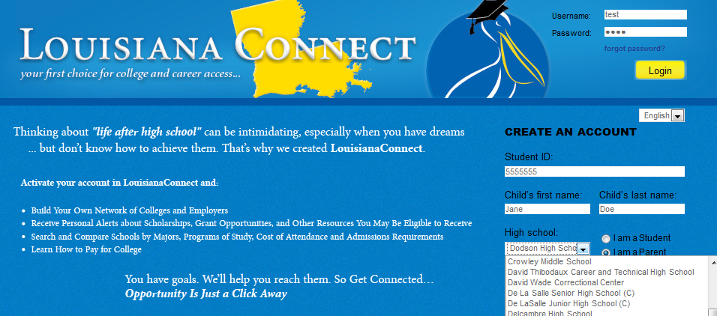
Select their school from the Dropdown List

Slide 27
Click “Register”

Slide 28
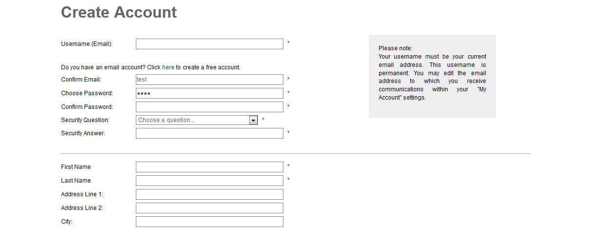
Create Your Account

Slide 29
Federal Government
Largest source of financial aid
Aid awarded primarily on the basis of financial need
Must apply every year using the Free Application for Federal Student Aid (FAFSA)

Slide 30
Common Federal Aid Programs
Federal Pell Grant
Teacher Education Assistance for College and Higher Education Grant
Federal Supplemental Educational Opportunity Grant
Federal Perkins Loan
Federal Work-Study
Subsidized and Unsubsidized Loans
PLUS Loans

Slide 31
States
Residency requirements
Award aid on the basis of both merit and need
Use information from the FAFSA
Deadlines vary by state; check paper FAFSA or FAFSA on the Web site

Slide 32
Private Sources
Foundations, businesses, charitable organizations
Deadlines and application procedures vary widely
Begin researching private aid sources early

Slide 33
Civic Organizations and Churches
Research what is available in community
To what organizations and churches do student and family belong?
Application process usually spring of senior year
Small scholarships add up!

Slide 34
Employers
Companies may have scholarships available to the children of employees
Companies may have educational benefits for their employees

Slide 35
Free Application for Federal Student Aid (FAFSA)
A standard form that collects demographic and financial information about the student and family
May be filed electronically or using paper form
Available in English and Spanish

Slide 36
FAFSA
Information used to calculate the Expected Family Contribution or EFC
The amount of money a student and his or her family may reasonably be expected to contribute towards the cost of the student’s education for an academic year
Colleges use EFC to award financial aid

Slide 37
FAFSA
May be filed at any time during an academic year, but no earlier than the January 1st prior to the academic year for which the student requests aid
For the 2012–13 academic year, the FAFSA may be filed beginning January 1, 2012
Colleges may set FAFSA filing deadlines

Slide 38
FAFSA on the Web
Website: www.fafsa.gov
2012–13 FAFSA on the Web available on January 1, 2012
FAFSA on the Web Worksheet:
Used as “pre-application” worksheet
Questions follow order of FAFSA on the Web

Slide 39
FAFSA on the Web
Good reasons to file electronically:
Built-in edits to prevent costly errors
Skip logic allows student and/or parent to skip unnecessary questions
Option to use Internal Revenue Service (IRS) data retrieval

Slide 40
FAFSA on the Web
Good reasons to file electronically:
More timely submission of original application and any necessary corrections
More detailed instructions and “help” for common questions
Ability to check application status on-line
Simplified application process in the future

Slide 41
IRS Data Retrieval
While completing FOTW, applicant may submit real-time request to IRS for tax data
IRS will authenticate taxpayer’s identity
If match found, IRS sends real-time results to applicant in new window
Applicant chooses whether or not to transfer data to FOTW

Slide 42
IRS Data Retrieval
Available early February 2012 for 2012–13 processing cycle
Participation is voluntary
Reduces documents requested by financial aid office

Slide 43
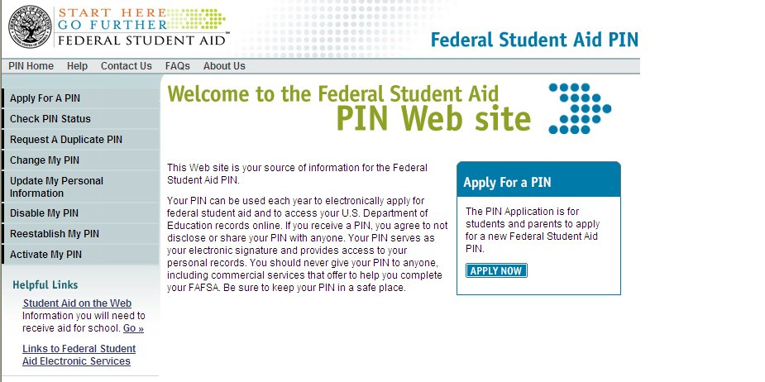
Federal Student Aid Personal Identification Number (FSA PIN)
Website: www.pin.ed.gov
Sign FAFSA electronically
Not required, but speeds processing
May be used by students and parents throughout aid process, including subsequent school years

Slide 44
FAFSA on the Web Worksheet
2012–13 FAFSA on the Web Worksheet— 4-page booklet containing:
Instructions
22 questions in 4 sections

Slide 45
FOTW Worksheet: Section 1
General student information:
Social Security Number
Citizenship status
Drug convictions
Selective Service registration

Slide 46
FOTW Worksheet: Section 2
Student’s dependency status:
If all “No” responses, student is dependent
If “Yes” to any question, student is independent

Slide 47
FOTW Worksheet: Section 3
Information about the parents of dependent students:
Tax, income, and other financial information
Dislocated worker status
Assets

Slide 48
FOTW Worksheet: Section 4
Information about the student (and spouse):
Tax, income, and other financial information
Dislocated worker status
Assets

Slide 49
Additional Information
College and housing information

Slide 50
Signatures
Required
Student
One parent (dependent students)
Format
Electronic using PIN
Signature page
Paper FAFSA

Slide 51
Frequent FAFSA Errors
Social Security Numbers
Divorced/remarried parental information
Income earned by parents/stepparents
Untaxed income
U.S. income taxes paid
Household size
Number of household members in college
Real estate and investment net worth

Slide 52
FAFSA Processing Results
Central Processing System (CPS) notifies student of FAFSA processing results by:
Paper Student Aid Report (SAR) if paper FAFSA was filed and student’s e-mail address was not provided
SAR Acknowledgement if filed FAFSA on the Web and student’s e-mail address was not provided

Slide 53
FAFSA Processing Results
CPS notifies student of FAFSA processing results by:
E-mail notification containing a direct link to student’s on-line SAR if student’s e-mail was provided on paper or electronic FAFSA
Student with PIN may view SAR on-line at www.fafsa.gov

Slide 54
FAFSA Processing Results
Institutional Student Information Record (ISIR) sent to colleges listed on FAFSA approximately 10 to 14 days after FAFSA submitted
College reviews ISIR
May request additional documentation, such as proof that a sibling is enrolled in college

Slide 55
Student Aid Report
Review data for accuracy
Update estimated information when actual figures are available

Slide 56
Making Corrections
If necessary, corrections to FAFSA data may be made by:
Using FAFSA on the Web (www.fafsa.gov) if student has a PIN;
Updating paper SAR (SAR Information Acknowledgement cannot be used to make corrections); or
Submitting documentation to college’s financial aid office

Slide 57
Special Circumstances
Cannot report on FAFSA
Send written explanation to financial aid office at each college

Slide 58
Special Circumstances
Change in employment status
Medical expenses not covered by insurance
Change in parent marital status
Unusual dependent care expenses
Student cannot obtain parent information

