Slide 1
Creating an FSA ID

Slide 2
What is the FSA ID?
The FSA ID, which replaced the Federal Student Aid PIN in May 2015, is the username and password you use when you visit certain U.S. Department of Education websites.
It identifies you as someone who has the right to access your own personal information on ED websites such as the Free Application for Federal Student Aid (FAFSA®) at fafsa.gov.
The FSA ID is used to sign legally binding documents electronically. It has the same legal status as a written signature.

Slide 3
Using the FSA ID
Website | What You Can Do at the Site
fafsa.gov | Electronically sign your (or your child's) FAFSA Import your tax information from the Internal Revenue Service Prefill data in this year´s FAFSA if you filed a FAFSA last year (Renewal FAFSA) Make online corrections to an existing FAFSA View or print an online copy of your Student Aid Report (SAR)
My Federal Student Aid at StudentAid.gov/login or the National Student Loan Data System (NSLDS®) at www.nslds.ed.gov | View a history of any federal student aid that you have received Look up your loan servicer's contact information
StudentLoans.gov | Complete entrance counseling, the Financial Awareness Counseling Tool, or exit counseling Electronically sign a master promissory note (MPN). Complete PLUS loan requests Estimate your student loan payments using the Repayment Estimator Apply for an income-driven repayment plan or a consolidation loan
Agreement to Serve (ATS) at www.teach-ats.ed.gov | Sign your ATS for the Teacher Education Assistance for College and Higher Education (TEACH) Grant Program

Slide 4


Slide 5
What to Do:
I Forgot My Username or Password

Slide 6
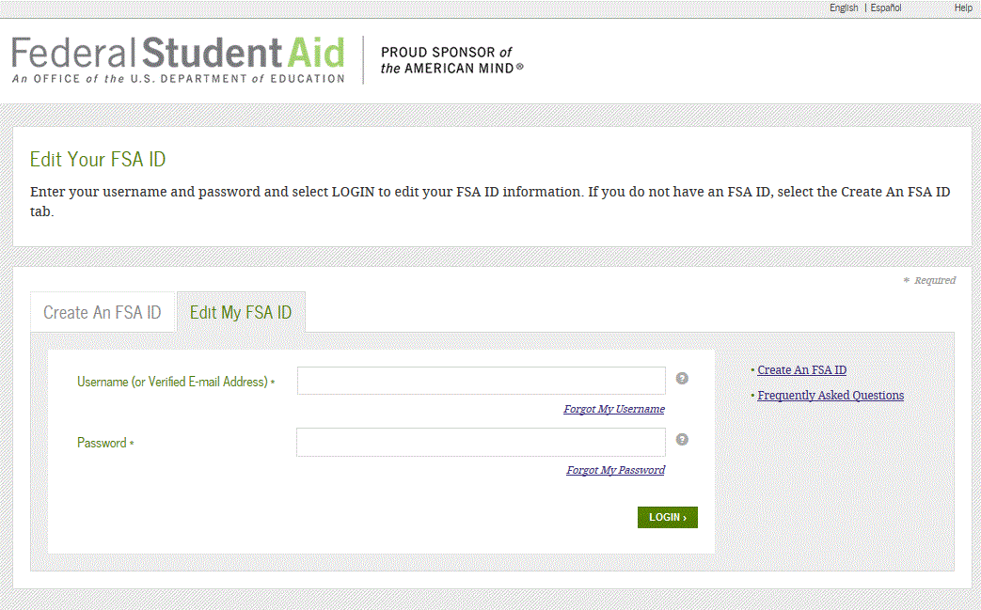
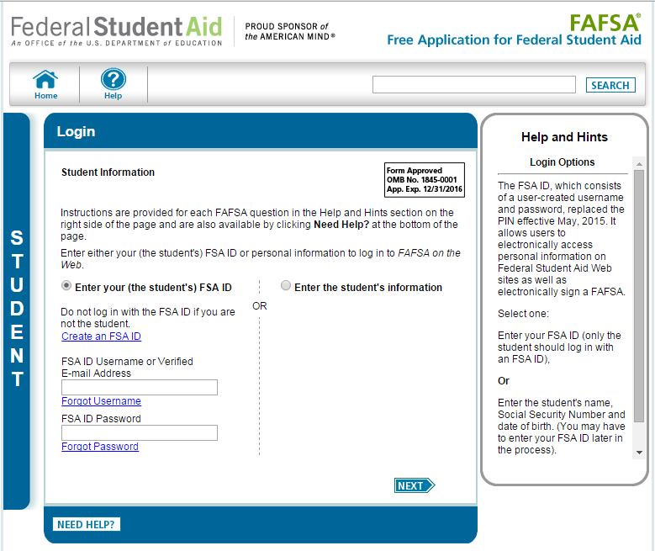
Forgot My Username
Select “Forgot My Username” at the Log In Screen
The appearance of the link may vary depending on what website you are visiting
Edit My FSA ID Screen
FAFSA Log In Screen

Slide 7
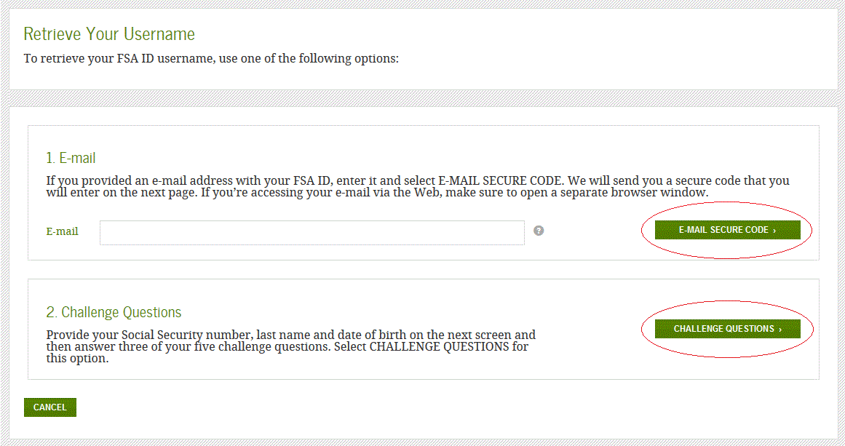
Forgot My Username
You can retrieve your username by either:
Having a secure code e-mailed to you (enter the e-mail address associated with your FSA ID account and click the “E-mail Secure Code” button)
Providing personal information and answering your challenge questions (click the “Challenge Questions” button)

Slide 8
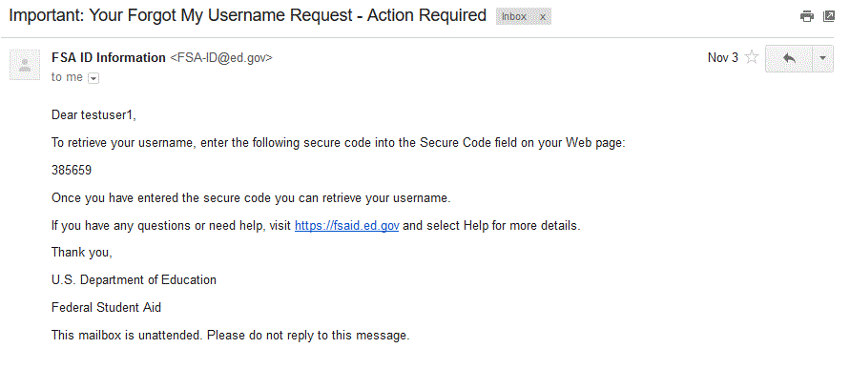
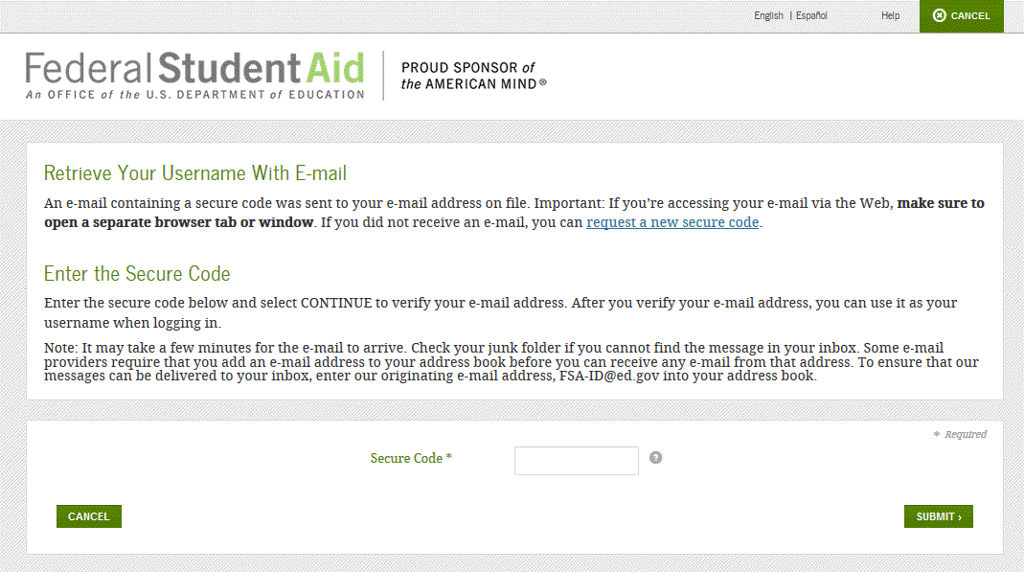
Retrieving Username Using Secure Code
If you selected “E-mail Secure Code,” an e-mail will be sent to your e-mail account and you will be taken to a page where you can enter a secure code
Do not close this page!
Open your e-mail in a new browser window or tab or different device and copy the code from your e-mail and enter it into the “Secure Code” box
E-mail With Your Secure Code

Slide 9
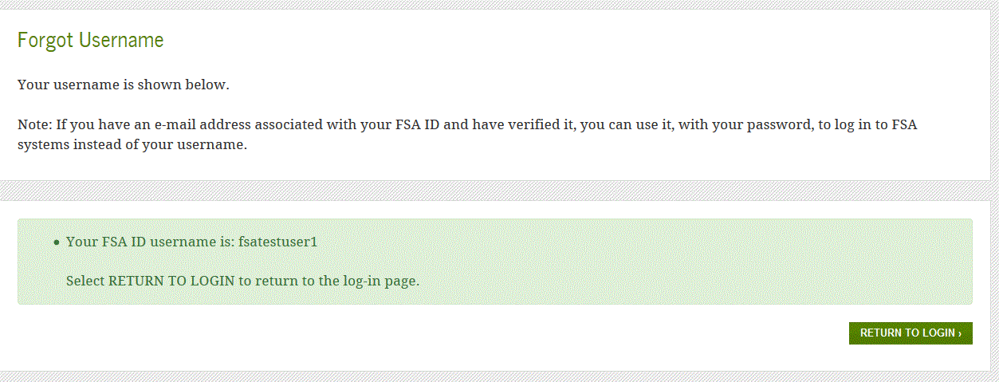
Retrieving Username Using Secure Code
Once you enter the secure code the screen will display your username

Slide 10
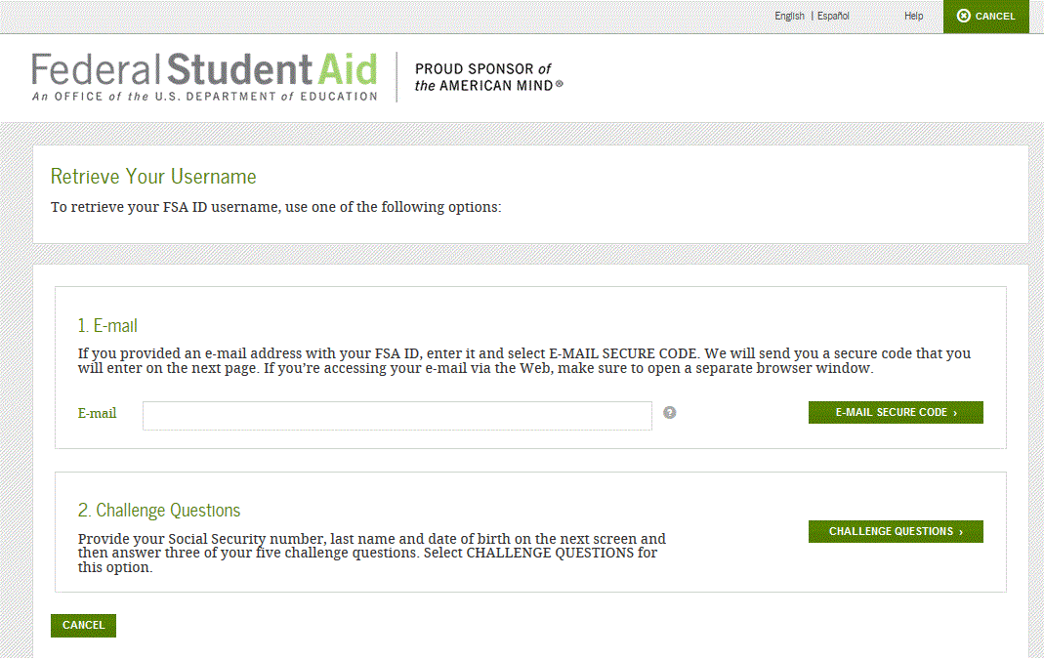
Forgot My Username
If you prefer to retrieve your username by answering your challenge questions, click the “Challenge Questions” button

Slide 11
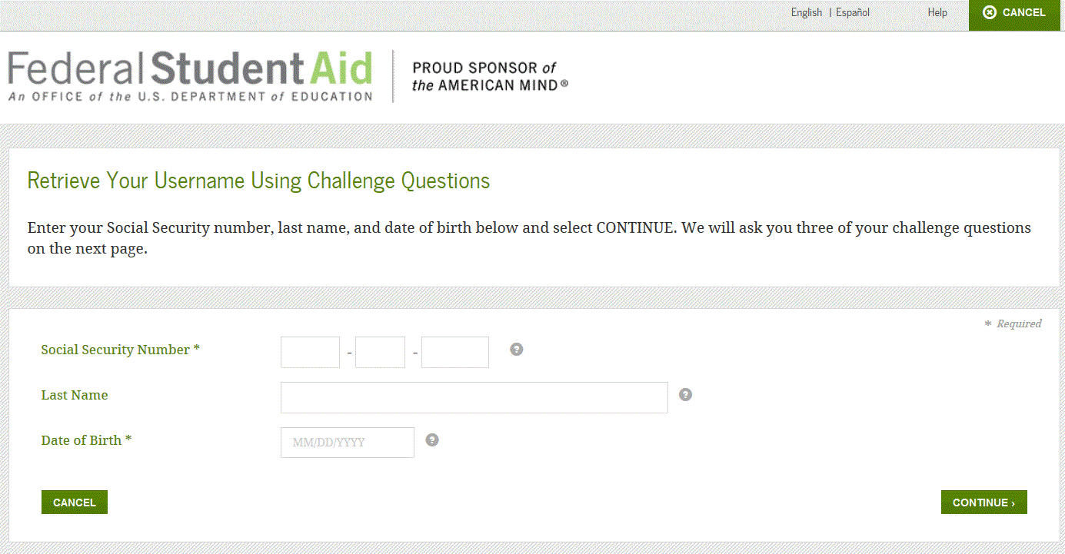
Retrieving Username Using Challenge Questions
If you selected “Challenge Questions,” you will be taken to a screen where you need to enter your Social Security number, last name, and date of birth

Slide 12
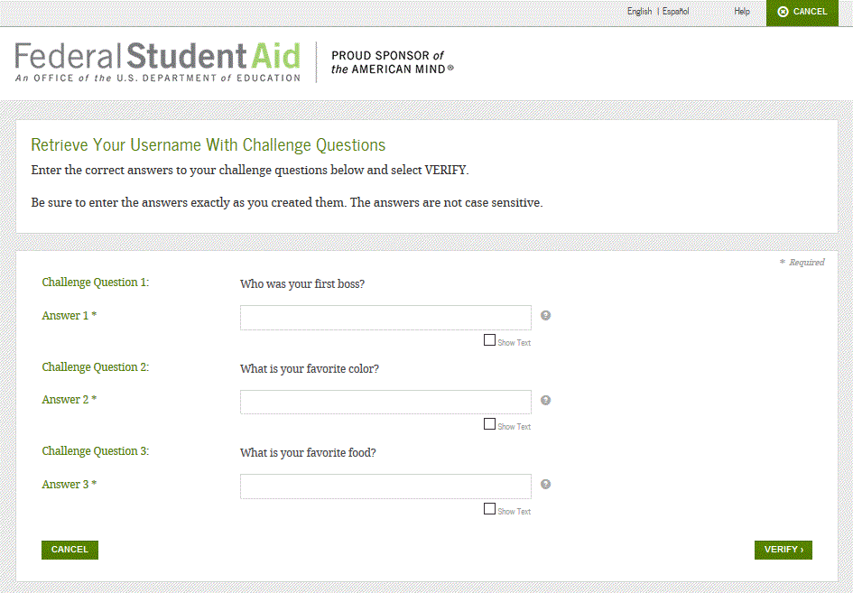
Retrieving Username Using Challenge Questions
IMPORTANT
If you retrieve your username using the challenge questions, you will need to wait 30 minutes before you can use your username

Slide 13
What to Do:
I’m Locked Out of My Account

Slide 14
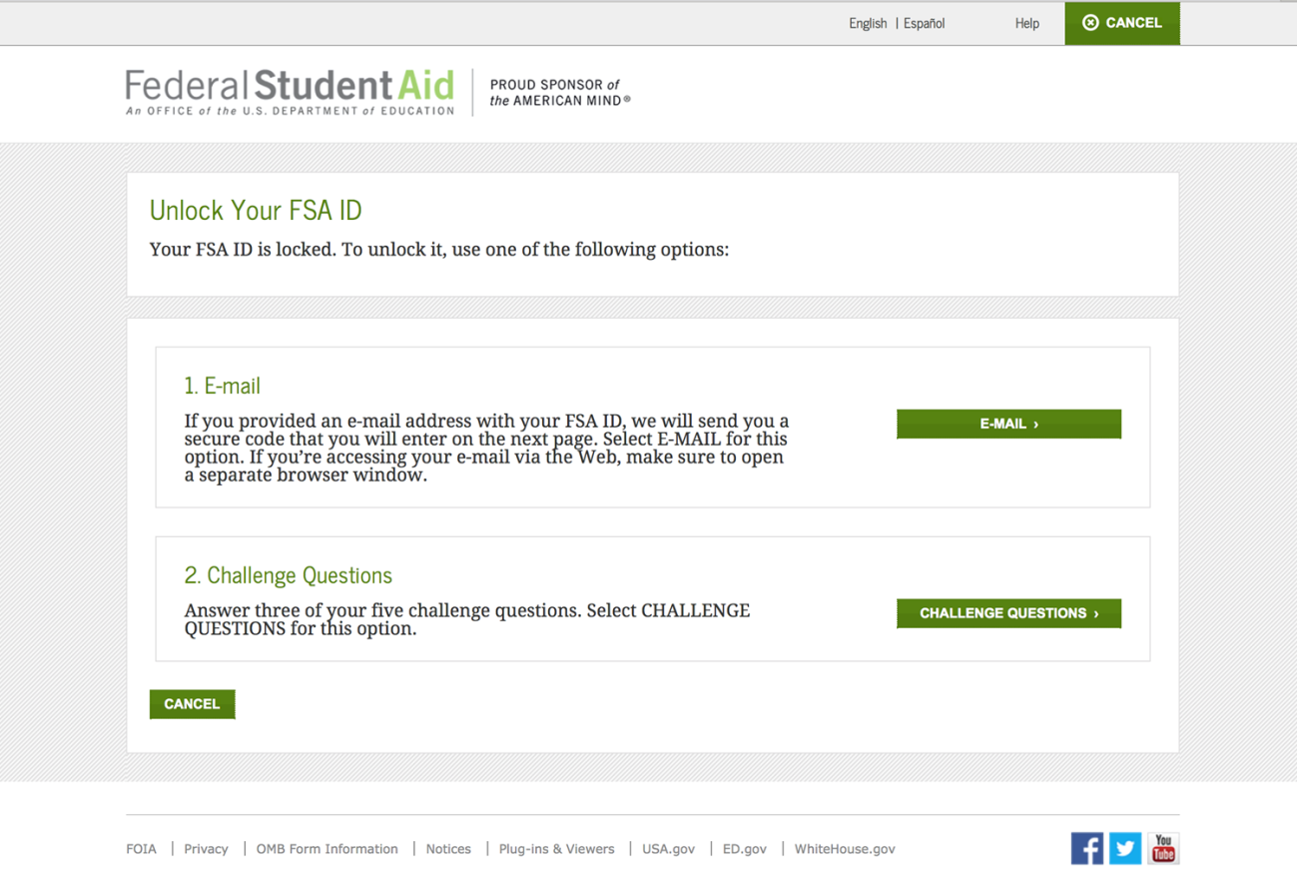
Locked Out
If you’ve been locked out of your FSA ID account for providing the wrong username or password, you can unlock your account using either e-mail or the challenge questions

Slide 15
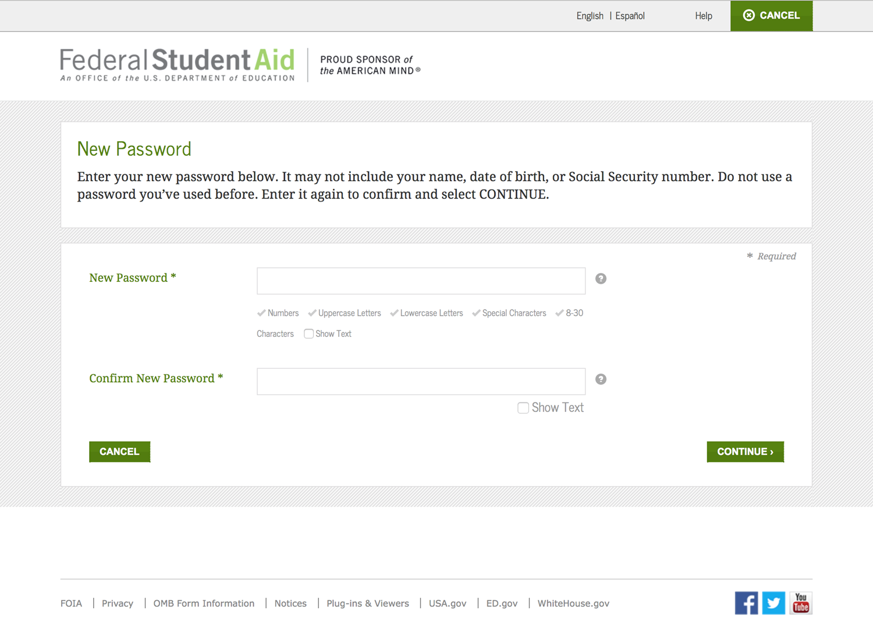
Locked Out
Once you successfully enter the secure code or answer your challenge questions, you will be taken to this screen to change your password

Slide 16
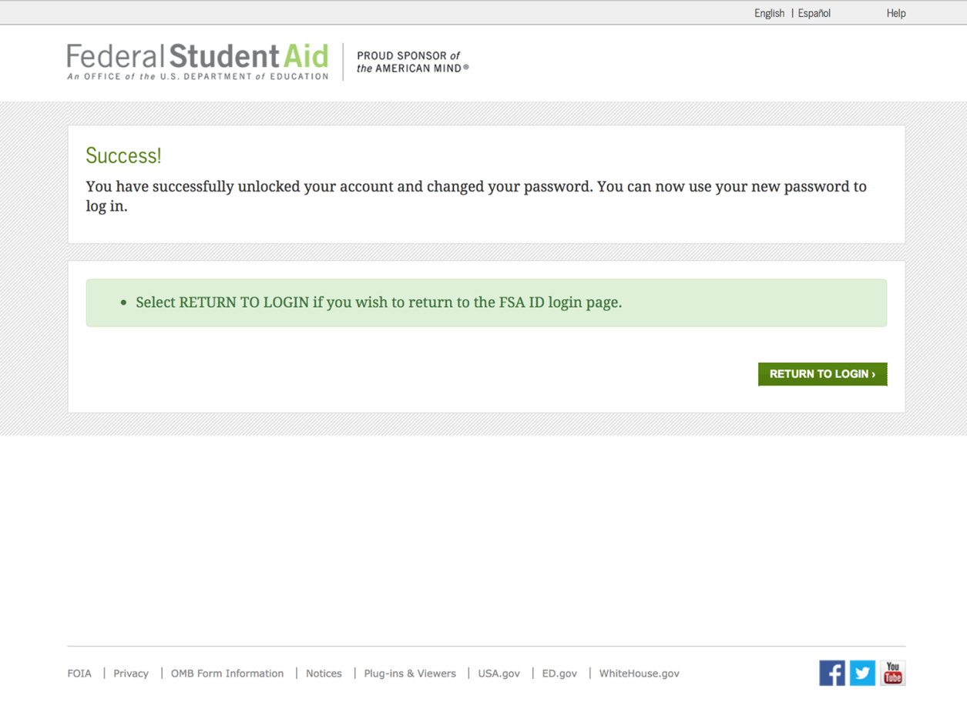
Locked Out
Once you enter a new password and re-enter it successfully, you receive the following message

Slide 17
Where can I get more information?

Slide 18
Where can I get more information?
Additional details on the FSA ID including answers to frequently asked questions and tips on creating an FSA ID, can be found at StudentAid.gov/fsaid

Slide 19
What You
Need to Know
About Financial Aid

Slide 20
Topics We Will Discuss Tonight
What is financial aid?
Cost of attendance (COA)
Expected family contribution (EFC)
Financial need
Categories, types, and sources of financial aid
Free Application for Federal Student Aid (FAFSA)

Slide 21

What is Financial Aid?
Financial aid consists of funds provided to students and families to help pay for postsecondary educational expenses

Slide 22
What is Cost of Attendance (COA)?
Direct costs
Indirect costs
Direct and indirect costs combined into cost of attendance
Varies widely from college to college

Slide 23
What is Expected Family Contribution (EFC)?
Amount family can reasonably be expected to contribute
Stays the same regardless of college
Two components
  Parent contribution
  Student contribution
Calculated using data from a federal application form and a federal formula

Slide 24
What is Financial Need?
Cost of Attendance
– Expected Family Contribution
= Financial Need

Slide 25
Categories of Financial Aid
Need-based aid
Non-need-based aid

Slide 26
Types of Financial Aid
Grants
Scholarships
Work-Study
Loans
Other
gift-aid
self-help
aid
Notes:
There are two basic types of financial aid: gift-aid and self-help.
Gift Aid is usually awarded in the form of grants and scholarships. It is assistance that generally does not have to be repaid.
Grants are usually awarded on the basis of a family’s financial need or limited ability to meet the costs of college.
Scholarships may be awarded to reward merit such as academic achievement, athletic ability, artistic talent, background, or other attributes you may possess.
Self-Help Aid requires you to take a bit more responsibility and includes work opportunities and loans.
Work-study aid helps students pay for education costs such as books, supplies, and personal expenses. It is a federal program that provides students with part-time employment to help meet their financial needs and give the student work experience. All funds awarded must be earned.
Student loans are financial aid that must be repaid. Most loans that are awarded based on financial need are low-interest loans sponsored by the federal government. There are other student loans that are not sponsored by the federal government and usually have higher fees and/or interest rates.

Slide 27
Gift Aid: Grants
Money that does not have to be paid back
Usually awarded on the basis of financial need

Slide 28
Gift Aid: Scholarships
Money that does not have to be paid back
Awarded on the basis of merit, skill, or unique characteristic

Slide 29

Self-Help Aid: Loans
Money students and parents borrow to help pay college expenses
Repayment usually begins after education is finished
Only borrow what is really needed
Look at loans as an investment in the future

Slide 30
Self-Help Aid: Work-Study Employment
Allows student to earn money to help pay educational costs
  A paycheck; or
  Nonmonetary compensation, such as room and board
Student may opt whether or not to work or number of hours to work

Slide 31
Sources of Financial Aid
federal
government
state
government
college
(institutional aid)
outside/
private
sources

Slide 32
Federal Government
Largest source of financial aid
Aid awarded primarily on the basis of financial need
Must apply each year using the FAFSA

Slide 33
Federal Student Aid Programs
Federal Pell Grant
Iraq and Afghanistan Service Grant (IASG)
Teacher Education Assistance for College and Higher Education (TEACH) Grant
Federal Supplemental Educational Opportunity Grant (FSEOG)
Federal Work-Study (FWS)
Subsidized and Unsubsidized Federal Direct Student Loans (Direct Loans)
PLUS Loans

Slide 34
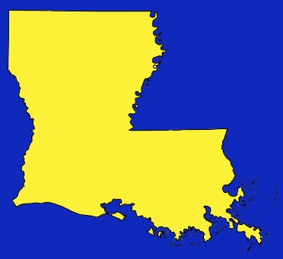
States
Residency requirements usually apply
Award aid on the basis of both merit and need
Use information from the FAFSA and/or state aid applications
Deadlines vary by state
  Check paper FAFSA or FAFSA on the Web website

Slide 35

Colleges and Universities
Award aid on the basis of both merit and need
Aid may be gift aid or self-help aid
Use information from the FAFSA and/or institutional applications
Deadlines and application requirements vary by institution
  Check with each college or university

Slide 36
Private Sources
Foundations, businesses, charitable organizations
Deadlines and application procedures vary widely
Begin researching private aid sources early

Slide 37
Civic Organizations and Churches
Research what is available in community
To what organizations and churches do student and family belong?
Application process usually occurs during spring of senior year
Small scholarships add up!

Slide 38

Employers
Companies may have scholarships available to the children of employees
Companies may have educational benefits for their employees

Slide 39

Free Application for Federal Student Aid (FAFSA)
A standard form that collects demographic and financial information about the student and family
May be filed electronically or using paper form
  Available in English and Spanish

Slide 40
FAFSA
Information used to calculate the expected family contribution (EFC)
  Amount of money a student and his or her family may reasonably be expected to contribute towards the cost of the student’s education for an academic year
Colleges use EFC to award financial aid

Slide 41
FAFSA
May be filed at any time during an academic year, but no earlier than the January 1st prior to the academic year for which the student requests aid
For the 2016–17 academic year, the FAFSA may be filed beginning January 1, 2016
Most colleges set FAFSA filing deadlines

Slide 42

FAFSA on the Web (FOTW)
Website: www.fafsa.gov
2016–17 FAFSA on the Web available on
January 1, 2016
FAFSA on the Web Worksheet:
  Used as “pre-application” worksheet
  Questions follow order of FAFSA on the Web

Slide 43
FAFSA on the Web
Good reasons to file electronically:
Built-in edits to prevent costly errors
Skip-logic allows student and/or parent to skip unnecessary questions
Option to use Internal Revenue Service (IRS) Data Retrieval Tool to import tax data

Slide 44
FAFSA on the Web
Good reasons to file electronically:
More timely submission of original application and any necessary corrections
More detailed instructions and “help” for common questions
Ability to check application status online
Simplified application process in the future

Slide 45
IRS Data Retrieval Tool
While completing FOTW, applicant may submit real-time request to IRS for tax data
IRS will authenticate taxpayer’s identity
If match found, IRS sends real-time results to applicant in new browser window
Applicant chooses whether or not to transfer data to FOTW

Slide 46
IRS Data Retrieval Tool
Available early February 2016 for 2016–17 processing cycle
Participation is voluntary
Reduces documents requested by financial aid office

Slide 47
IRS Data Retrieval Tool
Some will be unable to use IRS DRT
Examples include:
  Filed an amended tax return
  No Social Security Number (SSN) was entered
  Student or parent married but filed separately

Slide 48
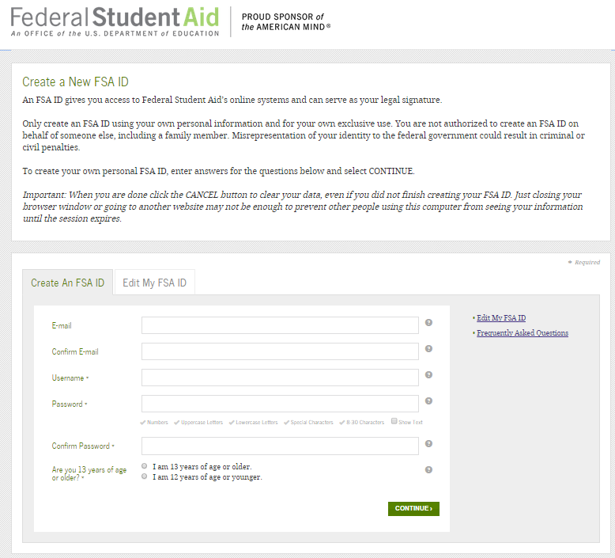
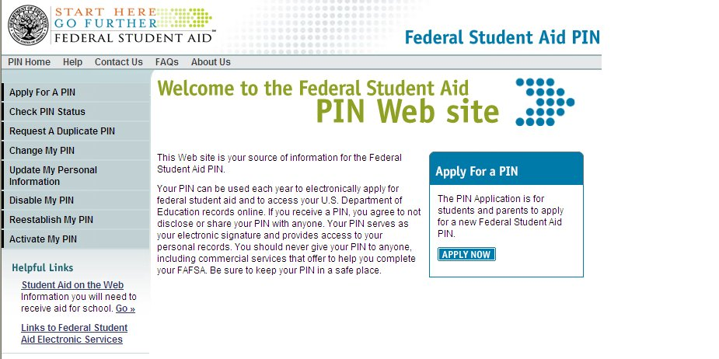
FSA ID
https://fsaid.ed.gov/npas/indexhtm
Sign FAFSA electronically
Not required, but speeds processing
May be used by students and parents throughout aid process, including subsequent school year
Only the owner should create a FSA ID

Slide 49
FAFSA on the Web Worksheet
FAFSA on the Web Worksheet contains:
Instructions
Questions that gather basic information on student and parent, if applicable

Slide 50
General Student Information
Social Security Number
Citizenship status
Marital status
Drug convictions
Selective Service registration
Level of parents’ school completion

Slide 51
Student Dependency Status
FAFSA asks questions to determine dependency status for federal student aid (not IRS) purposes:
If all “No” responses, student is dependent
If “Yes” to any question, student is independent

Slide 52
Information About Parents of
Dependent Students
Tax, income, and other financial information
Dislocated worker status
Receipt of federal means-tested benefits
Assets
Untaxed income

Slide 53
Information About Student (and Spouse)
Tax, income, and other financial information
Dislocated worker status
Receipt of federal means-tested benefits
Assets
Untaxed income

Slide 54
Additional Information
College and housing information
FAFSA preparer information
Certification of Statement of Educational Purpose

Slide 55

Signatures
Required
  Student
  One parent (dependent students)
Format for submitting signatures
  Electronic using FSA ID
  Signature page
  Paper FAFSA

Slide 56
Frequent FAFSA Errors
Social Security Numbers
Divorced/remarried parental information
Income earned by parents/stepparents
Untaxed income
U.S. income taxes paid
Household size
Number of household members in college
Real estate and investment net worth

Slide 57
FAFSA Processing Results
Central Processing System (CPS) notifies student of FAFSA processing results by:
Paper Student Aid Report (SAR) if paper FAFSA was filed and student’s email address was not provided
SAR Acknowledgement if filed FAFSA on the Web and student’s email address was not provided

Slide 58
FAFSA Processing Results
CPS notifies student of FAFSA processing results by:
  Email notification containing a direct link to student’s online SAR if student’s email was provided on paper or electronic FAFSA
Student with FSA ID may view SAR online at www.fafsa.gov

Slide 59
FAFSA Processing Results
Institutional Student Information Record (ISIR) sent to colleges listed on FAFSA approximately 10 to 14 days after FAFSA is submitted
College reviews ISIR
  May request additional documentation

Slide 60

Student Aid Report
Review data for accuracy and correct any errors
Update estimated tax information when actual figures become available

Slide 61
Making Corrections
If necessary, corrections to FAFSA data may be made by:
Using FAFSA on the Web (www.fafsa.gov) if student has a FSA ID;
Updating paper SAR (SAR Information Acknowledgement cannot be used to make corrections); or
Submitting documentation to college’s financial aid office

Slide 62

Questions
Questions/Comments

Slide 63
Miracle Davis
August 2, 2016
Verification: 101

Slide 64
What does it mean to be selected for Verification?
Verification is the confirmation through documentation that the information provided on a student's Free Application for Federal Student Aid (FAFSA) is correct. The federal government requires colleges and universities to verify or confirm the data reported by students and their parent(s) on the FAFSA.

Slide 65
Required Written Policies and Procedures
Deadlines for student to provide documentation and consequences of failure to meet deadlines
Method by which students are notified of award changes resulting from verification
Procedures for correcting FAFSA data
Procedure you will follow to refer a student to the Office of Inspector General

Slide 66
Notification to Selected Students
School must provide a written statement providing a clear explanation of the documents required for student to submit for verification.
Student’s responsibilities with regard to the verification process. This includes correction procedures, deadlines for completing any actions required & consequences of missing deadlines.
Notification methods that the school will use to notify students of award changes as a result of verification and the time frame for notification.

Slide 67


How Are Applicants Selected?
CPS selection
  Edit checks which identify inconsistencies and potential errors
  Random selection
School selection
  Criteria set by school

Slide 68
Verification Exclusions
Death of the student.
Not an aid recipient. The student won’t receive Title IV aid for reasons other than a failure to complete verification. This includes being ineligible for that aid and withdrawing without receiving it.
The applicant is eligible to receive only unsubsidized student financial assistance.
Applicant verified by another school. The student completed verification for the current award year at another school before transferring.
Post enrollment. The student was selected for verification after ceasing to be enrolled at your school and all (including late) disbursements were made.

Slide 69
Required Verification Items
Household size
Number in college
Supplemental Nutrition Assistance
Program (SNAP) benefits
Child support paid
High school completion status
Identity/statement of educational purpose
Adjusted gross income (AGI)
U.S. income tax paid
Education credits
Untaxed IRA distributions
Untaxed pensions
IRA deductions and payments
Tax-exempt interest
Other untaxed income
Income earned from work

Slide 70
Documents Needed for Verification
Verification Worksheet
  Household size
  Number of household members in college
Department of Education forms or School created forms
Appropriate Tax Forms
  IRS Tax Data Retrieval Tool (DRT)
  IRS Tax Return Transcript
  IRS Form 4868 (Filing extensions)
  W-2’s/1099’s
  Other signed IRS forms with tax data
  Non-filer tax statement
Signed statement or official agency documentation for untaxed income and benefits

Slide 71
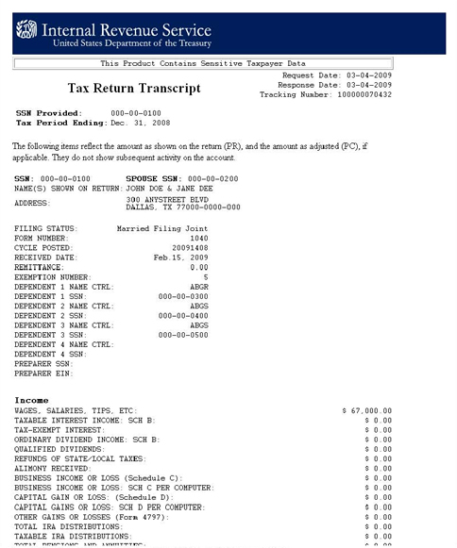
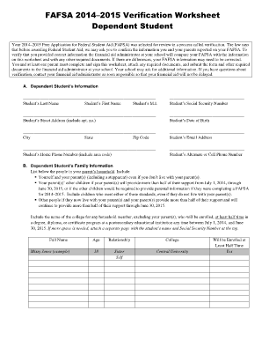
How to Verify?
Compare the verification documents with the original FAFSA information
May create own checklist/spreadsheet
May use verification tool on FAA Access
Determine that information is correct or corrections must be made

Slide 72
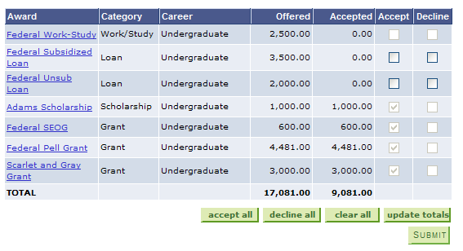
What Happens Next?
Financial Aid Award is posted!!!

Slide 73
Miracle Davis
August 2, 2016
Professional Judgment: 101

Slide 74

Professional Judgment
Definition – Professional Judgment is the Authority provided under the Higher Education Act for aid administrators to exercise discretion in specific areas of student aid administration

Slide 75
Importance of PJ
We (FA Administrators) have flexibility in dealing with unique circumstances
We are allowed opportunities to deal with special circumstances which cannot be anticipated by legislation
Through PJ, we are able to analyze students’ situation on a case-by-case basis that is not possible through the methodology.

Slide 76
Circumstances that are not unusual, does not merit PJ
Parents refusing to contribute to the student’s education;
Parents unwilling to provide information on the application or for verification;
Parents not claiming the student as a dependent for income tax purposes; and/or
Student demonstrating total self-sufficiency.
No Parental Information

Slide 77

Questions?

Slide 78
Southern University and A & M College miracle_davis@subr.edu
(225) 771-2790
Miracle Davis
Associate Director of Financial Aid

Slide 79

Don’t Blow Your TOPS!
It pays to make good grades!

Slide 80
TOPS
TOPS is funded through the State General Fund and the Millennium Trust Fund
  TOPS funding is contingent upon legislative appropriations each year

Slide 81
Citizenship
A student must be a U.S. citizen, or a permanent resident who is eligible to apply for citizenship
Beginning with 2019 high school graduates, children of non-citizens serving in the Armed Forces or honorably discharged from the Armed Forces meet TOPS citizenship requirements.

Slide 82
Residency
Any student who is a resident of the state and who graduates from a public or approved non-public high school meets the TOPS residency requirements if he or she actually resides or lives in Louisiana for the period of his or her last two full years of high school culminating in graduation as certified by the high school
Or, a parent or custodian of a dependent student must have been a resident of the state of Louisiana for the 24 months prior to high school graduation

Slide 83
Residency: Military Dependents
A dependent of a member of the U.S. Armed forces, who is transferred to Louisiana under permanent change of station orders, will be considered a resident for purposes of TOPS if the military member:
  Changes his/her military personnel records to establish Louisiana as the member’s official state of residence within 180 days of reporting
  Complies with Louisiana income tax laws
  Submits an Affidavit of Residency and DD Form 2058

Slide 84
Criminal Record
Have no criminal convictions
  Excludes misdemeanor traffic violations
A student who has a “final criminal conviction” may not accept a TOPS award
  A juvenile conviction is not considered a “final criminal conviction” regardless of the nature of the offense
    If the severity of the crime committed by a juvenile is such that he/she is tried as an adult, a subsequent conviction could be a “final criminal conviction”
  The student should contact his/her attorney to determine if their conviction is a final “criminal conviction”

Slide 85
Graduation Year
For TOPS purposes, the annual academic year for high school begins on September 1 and ends on the following August 31

Slide 86
Early Graduation
Students who graduate early at mid-year will be eligible for a TOPS Award in the Spring semester following graduation
  Certification for mid-year graduates will be done in conjunction with certification of May graduates
  Awards for mid-year graduates who attend college in the Spring and who are determined eligible will be paid retroactively
Students who graduate early in the Spring will be eligible for a TOPS award in the Fall semester following graduation
Students who graduate early must comply with the same FAFSA and ACT deadlines applicable to the class that graduates in the Spring of that high school academic year

Slide 87
TOPS Core Curriculum
All TOPS core curriculum courses must be completed by the date of high school graduation
Distance learning courses approved by the high school may be used to qualify for TOPS
College courses taken in the classroom, online, or by correspondence may be used to qualify for TOPS provided that they are determined to be equivalent courses and appear on the student’s official high school transcript
Effective for the graduating class of 2018, the TOPS Core Curriculum requirements and the method of calculating the grade point average required for program awards will change.

Slide 88
TOPS Core Curriculum – 19 Units
For students graduating in 2014 - 2017
English – 4 Units
Math – 4 Units
Science – 4 Units
Social Studies – 4 Units
Foreign Language – 2 Units (same language)
Fine Arts – 1 Unit (or 1 Performance, Studio, Visual Art or Speech III & IV)

Slide 89
TOPS Core Curriculum
Advanced Placement (AP) courses and International Baccalaureate (IB) courses with the same name as a course listed in the TOPS Core Curriculum may be substituted.
The unit compromised of ½ Unit of Civics and ½ Unit of Free Enterprise may NOT be used by students in public schools to meet high school graduation requirements if they entered the ninth grade after June 30, 2011, but can be used by students in public and non-public schools to meet the TOPS Core Curriculum requirements.

Slide 90
TOPS Core Curriculum GPA
The cumulative grade point average (GPA) for a TOPS award will be calculated using only those grades achieved in the core curriculum courses
  If a student has completed more than 19 credits for courses that are included in the core curriculum, the GPA will be calculated by using the course in each core curriculum category for which the student received the highest grade

Slide 91
TOPS Core Curriculum GPA
  If a student is substituting two units for a one unit category, the grades from the two units will be averaged together and substituted as one unit
  “P” grades are not included in the TOPS Core GPA calculation
  For high schools using any grading scale other than a 4.00 scale, all grade values must be converted to a 4.00 scale (through the graduating class of 2016 – 2017)
  GPA cannot be rounded up

Slide 92
ACT
Highest composite score will be considered
  TOPS does not consider the Essay portion of the ACT in calculating the composite score needed to qualify
ACT Registration
  TOPS Code 1595
  Date of Birth

Slide 93
ACT
ACT Deadlines for 2017 Graduates
  Without penalty: April 8, 2017
  Loss of one semester eligibility: June 10, 2017
    Special tests may be taken prior to July 1
    A June ACT score cannot be used to upgrade an Opportunity award to an Honors or Performance award
    A June ACT score can be used to upgrade a Tech Award to an Opportunity Award with a one semester or two quarter penalty
  Students who fail to achieve a qualifying ACT score by July 1 of the graduating year shall not be considered for an award

Slide 94
SAT
An equivalent SAT score may be substituted for the ACT score
  TOPS does not consider the Essay portion of the SAT in calculating the composite score needed to qualify
SAT Registration
  Scholarship Code 9019
SAT Test Deadlines
  Without Penalty: March 11, 2017
  Loss of 1 semester eligibility: May 6, 2017 and June 3, 2017

Slide 95
Opportunity Award:
Eligibility Requirements
2.50 minimum TOPS Core Curriculum GPA
ACT score equal to the prior year’s state average, but never less than 20
  20 for 2017 graduates
    SAT score of 1020
Completion of the TOPS Core Curriculum
TOPS general eligibility requirements

Slide 96
Opportunity Award Benefits
TOPS does not cover academic excellence fees, energy surcharges, technology fees, books, room & board, parking fees, lab fees or any other fee that was not in effect on January 1, 1998
A TOPS award may be combined with other forms of financial aid up to the “Cost of Attendance” for the institution

Slide 97
TOPS Eligible Institutions: Public
Louisiana State University System
  Louisiana State University – Alexandria
  Louisiana State University – Baton Rouge
  Louisiana State University – Eunice
  Louisiana State University – Shreveport
  LSU Health Sciences Center – New Orleans
  LSU Health Sciences Center – Shreveport
  University of New Orleans
Southern University System
  Southern University – Baton Rouge
  Southern University – New Orleans
  Southern University – Shreveport

Slide 98
TOPS Eligible Institutions: Public
University of Louisiana System
  Grambling State University
  Louisiana Tech University
  McNeese State University
  Nicholls State University
  Northwestern State University
  Southeastern Louisiana University
  University of Louisiana – Lafayette
  University of Louisiana – Monroe

Slide 99
TOPS Eligible Institutions: Public
Louisiana Community and Technical College System
  Louisiana Technical College – all campuses
  Baton Rouge Community College
  Bossier Parish Community College
  Delgado Community College
  L.E. Fletcher Technical Community College
  Louisiana Delta Community College
  Nunez Community College
  River Parishes Community College
  South Louisiana Community College
  SOWELA Technical Community College

Slide 100
TOPS Eligible Institutions: Private
Louisiana Association of Independent Colleges and Universities (LAICU)
  Centenary College
  Dillard University
  Louisiana College
  Loyola University New Orleans
  New Orleans Baptist Theological Seminary
  Our Lady of Holy Cross College
  Our Lady of the Lake College
  St. Joseph Seminary College
  Tulane University
  Xavier University

Slide 101
TOPS Eligible Institutions:
Out-of-State
Deaf or hard of hearing recipients of the Opportunity, Performance or Honors awards may use the award at a non-public, out-of-state college or university which primarily serves deaf or hard of hearing students
TOPS may not be used out-of-state under any other circumstances

Slide 102
Opportunity Award Benefits
May be used to pursue:
  Academic undergraduate degree
  Vocational or technical certificate
  Non-academic degree
Students who use their Opportunity Award to pursue a technical program will receive the same benefits and be held to the same retention requirements as a TOPS Tech Award recipient
  The award may be used at eligible Louisiana cosmetology and proprietary schools
  See TOPS Tech Award presentation

Slide 103
Opportunity Award Benefits
May be received for a maximum of eight semesters or 12 quarters
Not available for summer terms except for students enrolled in a Qualified Summer Session
  Students with 60 or more hours
  Required to attend summer by major
  Courses required for major only offered in summer
  Technical Programs

Slide 104
Opportunity Award Benefits
Any recipient who successfully completes a Bachelor’s degree in less than 8 semesters or 12 quarters of award benefits, may receive any remaining terms of eligibility for graduate study
  Performance and Honors award recipients will receive their stipends

Slide 105
Performance Award
Eligibility Requirements
  3.00 minimum TOPS Core Curriculum GPA
  ACT score of 23
    SAT score of 1130
  Completion of the TOPS Core Curriculum
  TOPS general eligibility requirements
Award Benefits
  Provides the same benefits as the Opportunity Award, plus
  $400 annual stipend (contingent upon appropriations)

Slide 106
Honors Award
Eligibility Requirements
  3.00 minimum TOPS Core Curriculum GPA
  ACT score of 27
    SAT score of 1280
  Completion of the TOPS Core Curriculum
  TOPS general eligibility requirements
Award Benefits
  Provides the same benefits as the Opportunity Award, plus
  $800 annual stipend (contingent upon appropriations)

Slide 107
Disabled Students &
Exceptional Children
A core curriculum course may be waived for a disabled student or exceptional child if documentation is provided that the reason the student failed to successfully complete the course was due solely to the student’s disability or exceptionality
There is no exception to the GPA or ACT/SAT requirements
  ACT or SAT Special Testing for Students with Disabilities is available
Affected students should contact LOSFA for details

Slide 108
TOPS Application
There are two methods for applying for a TOPS Scholarship
  FAFSA (Free Application for Federal Student Aid) – www.fafsa.gov
    Must be completed if the student is eligible for federal grant aid (Pell Grant)
    Must be completed if the student is seeking any other form of financial aid
    The only application needed for TOPS
    OR
  TOPS Online Application – www.osfa.la.gov
    May only be completed by students who can certify that they do not qualify for federal grant aid
    Do not complete if you have completed the FAFSA

Slide 109
Application Deadlines for
2017 Graduates
Initial Application Receipt Date | Receives TOPS funding for:
Oct. 1, 2016 – July 1, 2018 | 8 semesters (12 quarters) Beginning Academic Year 2017-2018
July 2, 2018 – Aug. 29, 2018 | 7 semesters (10 quarters) Beginning Fall 2018
Aug. 30, 2018 – Oct. 29, 2018 | 6 semesters (9 quarters) Beginning Fall 2018
Initial Applications Received After October 29, 2018 | Ineligible for TOPS
Students who attend the 2017-2018 academic year who apply for TOPS between July 2, 2018 and October 29, 2018 must also have met the TOPS retention requirements to be eligible for TOPS funding at the beginning in the Fall 2018 semester

Slide 110
TOPS
Tech
Award

Slide 111
TOPS Tech Award
General Eligibility Requirements
Must be a U.S. citizen, or a permanent resident who is eligible to apply for citizenship
Must be a Louisiana resident
  See TOPS presentation for the definition
Must have no criminal convictions
  Excludes misdemeanor traffic violations

Slide 112
TOPS Tech Award
Eligibility Requirements
2.50 minimum TOPS or TOPS Tech Core Curriculum GPA
Minimum ACT score of 17
  SAT score of 900
  WorkKeys Silver Level Score
Completion of one the four TOPS Core Curricula
  Opportunity, Performance or Honors Award curriculum
  TOPS Tech Option 1
  TOPS Tech Option 2
  TOPS Tech Jumpstart Core Curriculum

Slide 113
TOPS Tech Core Curriculum
For students graduating through 2016-2017
Units | Courses
3 | English I, II, III
1 | English IV, Business English or Senior Applications in English
1 | Algebra I or Applied Algebra I or, Algebra I, Parts 1 & 2 (two units) or, Applied Mathematics I and II (two units)
2 | Geometry, Algebra II, Math Essentials, Advanced Mathematics - Pre-Calculus, Advanced Mathematics - Functions and Statistics, Financial Mathematics, Applied Mathematics III, Discrete Mathematics, Probability and Statistics or Applied Geometry
* Integrated Math I, II, and III can be substituted as a series for Algebra I, Geometry and Algebra II.

Slide 114
TOPS Tech Core Curriculum
For students graduating through 2016-2017
Units | Courses
1 | Biology
2 | Earth Science; Environmental Science; Physical Science; Integrated Science; Biology II; Chemistry II; Physics; Physics II; Physics for Technology; Anatomy and Physiology; Agriscience I&II (two units) Chemistry or Applied Chemistry

Slide 115
TOPS Tech Core Curriculum
For students graduating through 2016-2017
Units | Courses
1 | United States History
1 | World History, World Geography, Western Civilization, AP Human Geography, European History, or AP European History
1 | Civics and Free Enterprise (one unit, combined) or Civics (one unit)
13 Units, Plus Option 1 or Option 2

Slide 116
TOPS Tech Core Curriculum
For students graduating through 2016-2017
Option 1
Units | Courses
1 | Fine Arts Survey or 2 units of performance courses in music, dance or theater or 2 units of visual art or 2 units of studio art or a career/technical studies course approved by BESE or 1 unit of an elective from among the other subjects in this core curriculum or 2 units of Speech III and Speech IV or 1 unit of Drafting
2 | Foreign Language, Technical Writing, Speech I, or Speech II
1 | Computer Education program approved by BESE
17 Units

Slide 117
TOPS Tech Core Curriculum
For students graduating through 2016-2017
Option 2 – For students enrolled in a Career Major
Units | Courses
4 | A career major comprised of a sequence of specialty related courses as defined in the career options law
1 | Related or technical course
1 | A basic computer course
19 Units

Slide 118
TOPS Tech Core Curriculum
For students graduating in 2015-2016 and thereafter
Units | Courses
1 | English I
1 | English II
2 | English III, English IV, AP or IB English courses, Business English, Technical Writing, or comparable Louisiana Technical College courses offered by Jump Start regional teams as approved by the State Board of Elementary and Secondary Education.

Slide 119
TOPS Tech Core Curriculum
For students graduating in 2015-2016 and thereafter
Units | Courses
1 | Algebra I; or both Algebra I, Part 1 and Algebra I, Part 2; or an applied or hybrid algebra course
3 | Geometry, Algebra II, Math Essentials, Financial Literacy, Business Math, Algebra III, Advanced Math -Functions and Statistics, Advanced Math - Pre-Calculus, Pre-calculus, or comparable Louisiana Technical College courses offered by Jump Start regional teams as approved by the State Board of Elementary and Secondary Education. Integrated Mathematics I, II, and III may be substituted for Algebra I, Geometry, and Algebra II, and shall equal three mathematics credits

Slide 120
TOPS Tech Core Curriculum
For students graduating in 2015-2016 and thereafter
Units | Courses
1 | Biology
1 | Chemistry I, Earth Science, Environmental Science, Agriscience I and Agriscience II (both for one unit), Physical Science, or AP or IB science courses
1 | U.S. History, AP U.S. History, or IB U.S. History
1 | Civics, Government, AP U.S. Government and Politics: Comparative, or AP U.S. Government and Politics: United States

Slide 121
TOPS Tech Core Curriculum
For students graduating in 2015-2016 and thereafter
Units | Courses
9 | In Jump Start course sequences, workplace experiences, and credentials. A student shall complete a regionally designed series of Career and Technical Education Jump Start coursework and workplace-based learning experiences leading to a statewide or regional Jump Start credential. This shall include courses and workplace experiences specific to the credential, courses related to foundational career skills requirements in Jump Start, and other courses, including career electives, that the Jump Start regional team determines are appropriate for the career major.

Slide 122
TOPS Tech Award Benefits
May be used to pursue
  vocational or technical education certificate or diploma
  or non-academic degree in skill or occupational training
May receive for two years
Summer terms are covered for students attending a technical program
  Summer attendance is not required
  Funding is contingent upon appropriations

Slide 123
TOPS Tech Award Benefits:
Eligible Institutions
All Louisiana Community and Technical College System Institutions
All Louisiana public and LAICU colleges and universities offering skill, occupational, or technical training
Any Cosmetology school in Louisiana which has a current certificate of registration issued by the State Board of Cosmetology
Any accredited proprietary school which has a valid license issued by the Louisiana Board of Regents

Slide 124
LOSFA Special Programs

Slide 125
Other LOSFA Programs
Go Grant
TOPS Tech Early Start Program
Chafee Education & Training Voucher Program (ETV)
Rockefeller State Wildlife Scholarship
John R Justice Student Loan Repayment Program

Slide 126
Other LOSFA Programs
Strategies to Empower People (STEP) Program
START Saving Program
Supplemental Course Allocation

Slide 127
Go Grant

Slide 128
Go Grant
The Go Grant provides need-based financial aid for Louisiana residents
Program is administered by LOSFA on behalf of the Louisiana Board of Regents

Slide 129
Go Grant Framework
2016-2017
Award Amounts
  Award amounts to eligible students are based on the institutions allocation and their packaging policy.
  Awards may vary with each academic year
  Awards will not be paid for summer sessions, quarters or terms.

Slide 130
Go Grant Framework
2016-2017
Award Amounts, cont.
  Maximum and minimum annual award amounts for the 2016 – 2017 academic year:
    Minimum Annual Award - $300
    Maximum Annual Award - $3,000
    (Annual Award Amounts may vary based on each school’s packaging policy, but must not be less than $300 and must not exceed $3,000)

Slide 131
Go Grant
Eligibility Requirements
  Apply by completing the FAFSA annually
  Louisiana Resident as of the date the FAFSA is filed
  Certificate or degree seeking undergraduate student at a Louisiana public or LAICU institution
  Must receive a Pell Grant
  Must have a Remaining Financial Need (RFN)
  Must maintain Satisfactory Academic Progress (SAP) as defined by the institution

Slide 132
TOPS Tech
Early Start

Slide 133
TOPS Tech Early Start
This program provides an incentive for Louisiana’s public high school students to start early in preparing for a career in a qualifying Top Demand Occupation
Created in the Regular Session of the 2005 Louisiana Legislature
Funded as part of the TOPS Program

Slide 134
TOPS Tech Early Start
Eligibility Requirements
Be in “Good Standing” as an 11th or 12th grade student in a Louisiana PUBLIC high school (“Good Standing” is defined by the student’s high school
  Have an approved 5-Year Education and Career Plan
  Have a cumulative GPA of 2.00 on a 4.00 scale on all courses attempted
  Score a 15 or above on the mathematics AND English portion of the ACT PLAN Assessment or a successor assessment, or on the ACT, or the equivalent concordant value on the SAT, or have achieved a silver level score in an Industry-Based Occupational or Vocational Education Credential Program in a top demand occupation (Eligible Program)

Slide 135
Application
TOPS Tech Early Start Application in PDF format is available for download from www.osfa.la.gov

Slide 136
TOPS Tech Early Start
Award Benefits
Provides a payment of $50 per credit hour with a limit of $300 per semester
Award is limited to six credit hours per semester
Not available for summer sessions

Slide 137
TOPS Tech Early Start
Retention Requirements
Remain in “Good Standing” as an 11th or 12th grade student in a Louisiana public high school
Maintain a 2.00 GPA on a 4.00 scale on all high school courses attempted
Continue to pursue one or more courses leading to a credential in an Eligible Program
Remain in “Good Standing” with the public or nonpublic college or approved training provider
Maintain steady academic progress

Slide 138
Chafee Education & Training Voucher Program (ETV)

Slide 139
Chafee Education & Training Voucher Program (ETV)
Administered by LOSFA on behalf of the Louisiana Department of Children and Family Services
Available to students who are or were (prior to age 18) in the foster care system
Maximum Annual Award: $5,000

Slide 140
Chafee Education & Training Voucher Program (ETV)
Eligibility Requirements
  Ages 16-21 (age 23 if receiving ETV continuously since age 21)
  Enrolled in Louisiana public or LAICU institution or an approved Louisiana proprietary school
  Must complete the FAFSA annually
  Must have financial need
  Must make Satisfactory Academic Progress as defined by the institution
  The institution will notify LOSFA of any student meeting the eligibility criteria

Slide 141
Rockefeller State Wildlife Scholarship

Slide 142
Rockefeller State Wildlife Scholarship
Open to college juniors, seniors and graduate students majoring in Forestry, Wildlife or Marine Science at a Louisiana public institution
Maximum Annual Award:
  Undergraduate: $2,000
  Graduate: $3,000
Total Maximum Award: $12,000
  3 years undergraduate study
  2 years graduate study

Slide 143
Strategies To Empower People (STEP) Program

Slide 144
Strategies To Empower People (STEP) Program
LOSFA administers the STEP program in collaboration with the Department of Children and Family Services
The STEP Program assists Family Independence Temporary Assistance Program (FITAP) recipients with educational, training and work related activities designed to lead to employment and self-sufficiency.

Slide 145
Supplemental Course Allocation
(SCA)

Slide 146
Supplemental Course Allocation (SCA)
LOSFA administers the Supplemental Course Allocation (SCA) in collaboration with the Louisiana Department of Education
Enables districts and charter schools to simplify coursework taken for dual enrollmen and change course choice.

Slide 147
TOPS Legislative and Rule Changes

Slide 148
Act 18 of the 2016 Regular Session of the Louisiana Legislature sets a floor for the TOPS Award Amount beginning with the fall semester of 2016 and provides that the qualifying ACT score shall be truncated to a whole number rather than rounded to the next whole number. This change is effective beginning with the fall semester of 2016.

Slide 149
Act 388 of the 2016 Regular Session of the Louisiana Legislature increases the grade point average (GPA) requirement to qualify for a TOPS Performance Award from 3.0 to 3.25 and increases the GPA requirement to qualify for a TOPS Honors Award from 3.0 to 3.50. This change is effective for high school graduates of 2021 and later.

Slide 150
Act 503 of the 2016 Regular Session of the Louisiana Legislature changes the methodology for eliminating students’ TOPS Awards in the event of a budget shortfall. Under this law, when there is a budget shortfall, each student’s TOPS award -- including Performance and Honors Award stipends -- is subject to a reduction. TOPS Awards will be distributed to all students according to a pro-rata distribution of the available funds.
Neither the TOPS Tech Early Start Award nor the National Guard stipends are subject to reduction under this law.

Slide 151
Act 503 also allows a student to “opt out” of receiving his TOPS Award during a budget shortfall. Students will be required to log in to their Louisiana Award System account to reject payment of their TOPS Award during a budget shortfall year.
If the student rejects his TOPS Award, he will not be required to enroll full time in school or maintain continuous enrollment during that academic year. NOTE that the time period for students whose awards are suspended for failure to meet steady academic progress WILL NOT be extended, even if the student opts out. In addition, a student who opts out must use all of his TOPS eligibility within 5 years of the budget shortfall, which time may be extended if the student requests an exception for cause in accordance with the administrative rules. This change is effective beginning with the 2016-2017 award year.

Slide 152
FROM ACT 359 of the 2013 Legislature
Beginning with the high school graduating class of 2018, certain honors, advancement placement, gifted, and dual enrollment courses approved by BESE and the Board of Regents will be graded on a 5.0 grading scale for purposes of calculating students’ grade point average on the TOPS core curriculum courses.

Slide 153
FROM ACT 230 of the 2015 Legislature provides that 2017 high school graduates will be able to use the TOPS Tech Award to pursue an associate's degree or other shorter-term training and education programs, including skill, occupational, vocational, technical, certificate, and academic, that the Workforce Investment Council (WIC) and the Board of Regents (BOR) determine are aligned to state workforce priorities.

Slide 154
If one of the eligible programs becomes ineligible in future years, students who are currently in the program will be allowed to complete that program and receive their TOPS Tech Award. No new students would be eligible for TOPS Tech funding after a determination that the program has become ineligible.

Slide 155
All current TOPS Tech eligible programs remain eligible for 2017 high school graduates. Funding for all TOPS awards is contingent upon appropriations.

Slide 156
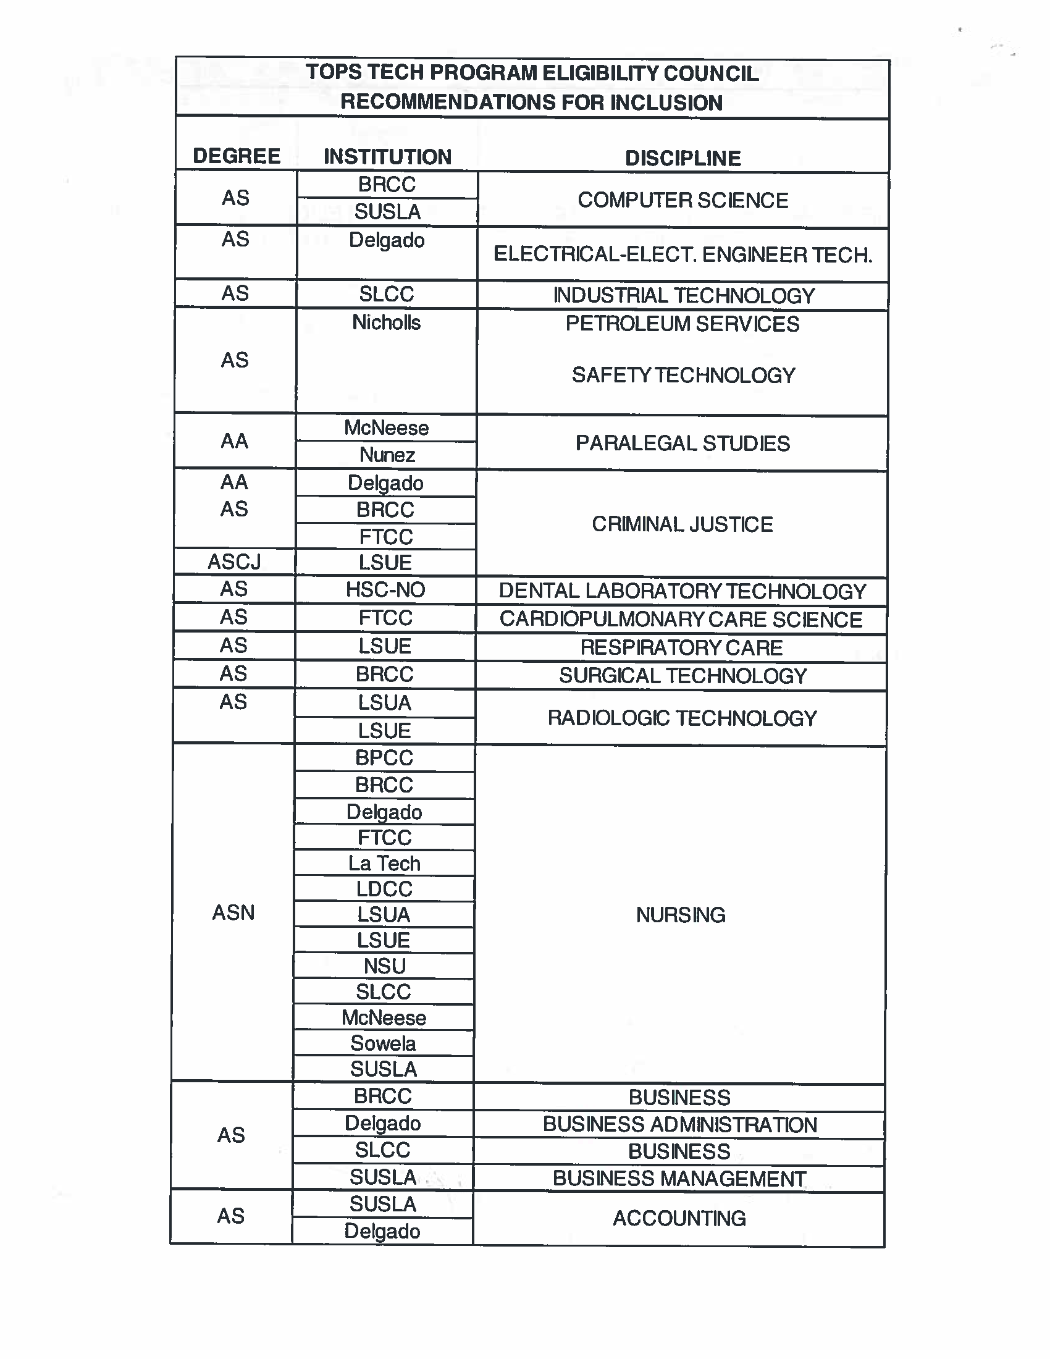

Slide 158
RULE CHANGE
The Board of Regents and the Board of Elementary and Secondary Education approved AP Computer Science as a course to be graded on a 5.0 grading scale at its joint meeting in June 2016 and as an allowable substitute for the fourth math requirement beginning with high school graduates of 2018 and thereafter.

Slide 159
A Consent Form for every student is required by the law to ensure that PII is disclosed only for those students whose parent or legal guardian has consented and that the parents who deny consent do so with full knowledge of the effect of denial of consent.
If you filled out a consent form during the 2015-16 the form will be good through the end of high school unless consent is revoked.

Slide 160
The Consent Form must be signed by the student rather than the parent or legal guardian if the student is 18 or is judicially emancipated or is emancipated by marriage.

Slide 161


Slide 162
    LCAM 2015 Overview
      86 schools / 41 parishes / 5, 526+ students / 9,676 applications completed
    LCAAM – Louisiana College Application and Access Month – October 2016
      Application & “Access”
        Encourage participation from students who are applying to 2 and 4 year institutions; as well as credential and career track students. ( Military and Job applications, My Life My Way (website), JumpStart credentials, etc.)
    Early Registration
      PDF registration ( sent by e-mail or downloaded from site ( Firefox) )
      LOSFA website online registration ( Chrome )

Slide 163
    Not a “Recruiting” Event
    LCAAM Admission – LOSFA Student Survey Pre-Event
      College Match and Fit
    Staffing/Volunteers
      LOSFA Staff
      Volunteers (recruited by schools) *Let us know who will attend/help out with your events.*
    Social Media
      #GeauxApply2017 #IHaveApplied2017
    Contact: Brandi Morrison - 225.219.7583 - brandi.Morrison@la.gov

