Slide 1
Louisiana’s First Choice for College Access
FLY: Financial Literacy for You

Slide 2
Budgeting – It pays to plan

Slide 3
Needs Versus Wants
Needs
  The things we really need in life are limited and include food, shelter, relationships and clothing
  Depending on how simple or extravagant you would like your needs to be will affect your budget
Wants
  Everything else

Slide 4
Set Goals: “The driver of your budget”
Short-term Goals: 6 – 24 months
  These are goals that you’ll save actively for in order to meet deadlines like car maintenance or cell phone bill
Mid-range Goals: 2-5 years
  These goals may be bigger picture items like paying down debt or saving a down payment for a house
Long-term Goals: 5+ years
  These are the big things such as retiring early or paying for a child’s college education

Slide 5
Budgets
Putting together a budget is something that many people intend to do but often fail to get done
The major thing that you want to shoot for with a budget is pretty simple; you need to spend less than you earn

Slide 6
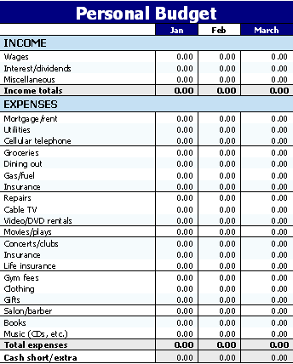
Use a Checkbook & a Spending Diary

Slide 7
The Little Things Add Up
Consider that if you download three songs a week at $.99, you’re on track to spend $155 per year
You may also find that eating out may be costing a lot, or you may find another expense area that is costing you a lot of cash

Slide 8
The Little Things Add Up
What would it cost you a year if you ate at McDonald’s once a week for a full day, even off of the $1 menu?
Total
Breakfast: $1 Biscuit, $1 Coffee $2
Lunch: $1 McDouble, $1 Fry, $1 Drink, $1 Apple Pie $4
Dinner: $1 McChicken, $1 Side Salad, $1 Drink $3
$9

Slide 9
$468

Slide 10
Rule of 72
The rule says that to find the number of years required to double your money at a given interest rate, you just divide the annual interest rate into 72
Example 1: 72 divided by 2% Interest (passbook account is less) = 36 years. In 36 years, $10,000 would become $20,000
  Open Account - $10,000
  Year 36 – $20,000

Slide 11
The Power of Compounding Interest
Compound interest simply means that interest earned gets added to the existing principal
For example, if you invest $100 earning an annual rate of 8% then you would have $108 ($100 + (100 x 0.08)) after one year
After two years you would have $116.64, and after three years you would have $125.97

Slide 12
Who will have more money at age 60?
A: If Jill, at the age of 22, starts investing $2,000 at the beginning of each year into a mutual fund for 10 years, stops contributing, but leaves the money in the mutual fund
B: At the age of 30, Jack starts putting $2,000 a year away into the same mutual fund until he reaches 60
The fund averages a 10% return for every year the money remains in the mutual fund

Slide 13
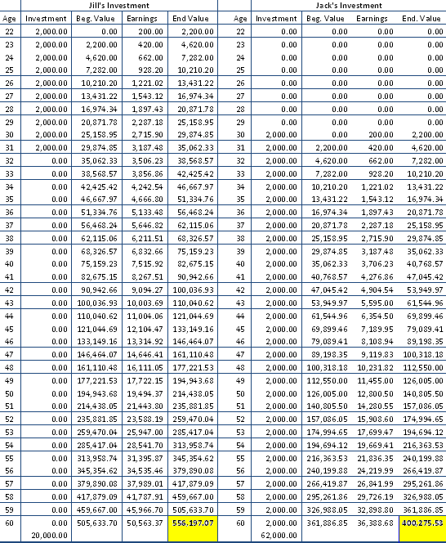

Slide 14
Checking Accounts
Ask Questions
Prevent Overdrafts
For example:
Freddy’s Pizza check = $15.86
Non-sufficient Funds (NSF) fee = $25.00
Pizza parlor charge for NSF check = $25.00
Total cost of pizza = $65.86

Slide 15
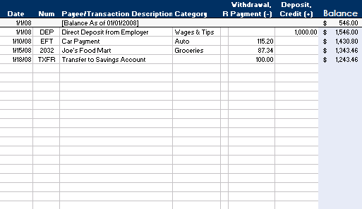
Checking Accounts
Record purchases
Reconcile

Slide 16
Debit Cards
Records all debit card purchases in your check register
Using a debit card to withdraw cash from an ATM can also be expensive
  ATM fees can be $2.00 or more per transaction

Slide 17
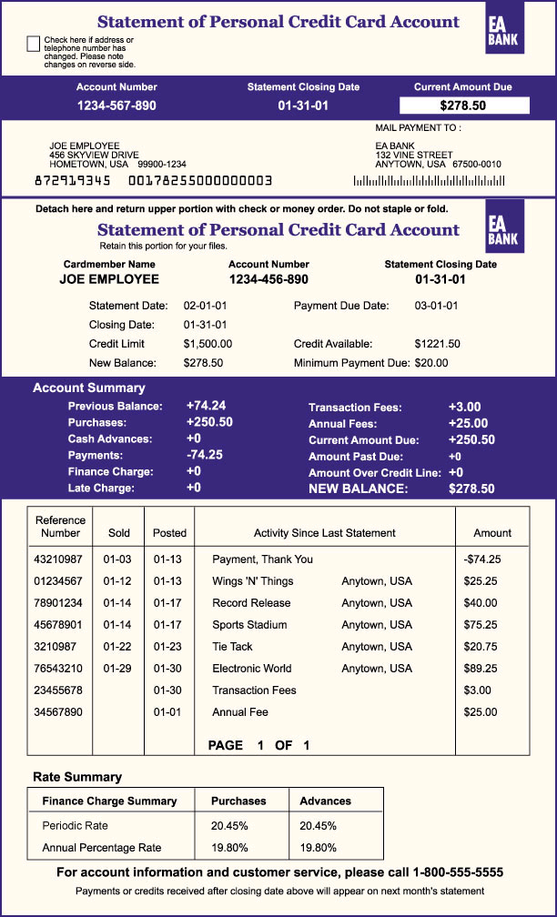
Credit Cards

Slide 18
Credit Cards
EXAMPLE: Sally Maxout has a card with a $3,000 credit limit, a balance of $2,985, and a 19% interest rate. She sends her minimum payment due of $168 in late and is looking at a lot of fees:
Balance: $2,985
Finance Charge: +$ 48
Late fee: +$ 35
New balance: $3,068
Over limit fee: +$ 35
New balance: $3,103
Payment: -$ 168
New Balance: $2,935

Slide 19
Credit Card Tips
Put Away the Plastic
  Don’t use a credit card unless your debt is at a manageable level and you know you’ll have the money to pay the bill when it arrives
  80% of undergraduate students have a credit card in their name with an average outstanding balance of over $2,100.

Slide 20
Debt Management
Two methods to manage debt with interest rates:
  Pay off the debt with the Highest Interest Rate
  Pay off the Debt with the Lowest Payment Owed (the Snowball effect)

Slide 21
Debt Management
Pay off the Debt with the highest Interest Rate
  If you’ve got unpaid balances on several credit cards, you should first pay down the card that charges the highest rate. Pay as much as you can toward that debt each month until your balance is once again zero, while still paying the minimum on your other cards
www.sec.gov

Slide 22
Debt Management
Pay off the debt with the lowest payment owed
Type of Loan | Amount owed | Minimum Payment | Interest Rate | Priority
Credit Card | $1200 | $100 | 16% | 1
Student Loan | $5000 | $50 | 6.8% | 2
Collection Agency | $500 | $100 | 12% | 1 Paid
In the example you can see that this person pays $250 per month toward three debts. At $100 per month, the Collection Agency debt can be paid off in five months [technically, he would still have a balance of $10.20 if he did not pay a little more each month to cover the interest] . Once paid off, take the Collection Agency payment amount and add it to the current Credit Card payment for a total of $200 a month. This will save you $1812 in payments over continuing to pay the same payments on these debts.

Slide 23
Credit Scores
What is a credit score?
  It’s a complex mathematical model that evaluates many types of information in a credit file
  The score is used by creditors to determine your “risk factor” in paying back a loan. Generally, the higher the score, the less risk the person represents
What is a “good score”?
  Credit scores range from 350 to 850
  If your score is above 720 or so, you’ll more than likely get the best interest rate available on any loan

Slide 24
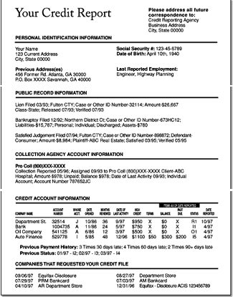

Slide 25
Credit Scores
Who looks at my credit score?
  Lenders
  Apartment managers
  Insurance agencies
  Employers
  Companies you want to do business with

Slide 26
Factors in Your Score

Slide 27
Credit Scores
Getting a better score
  Pay bills on time: get current and stay current
  Contact your creditors for help: Letting creditors know that you’re having trouble may minimize damage. Be truthful and nice to your creditors
  Keep balances low on revolving accounts such as credit cards
  Pay off debt instead of moving it around
  Don’t open a bunch of new credit card accounts that you don’t need

Slide 28
Credit Reports
How to get your credit report and score
  Contact one of the major credit reporting bureaus
    www.equifax.com
      For fraud alerts call 1.888.766.0008
    www.experian.com
      For fraud alerts call 1.888.397.3742
    www.transunion.com
      For fraud alerts call 1.800.680.7289
  Or visit the central site where you can order a free copy of your credit report from each of the three major credit bureaus: www.annualcreditreport.com

Slide 29
Credit Reports
Make sure it’s accurate
  Be sure to check your report and note anything that shouldn’t be there, such as accounts you’ve never opened, duplicate accounts, errors, and items that are more than seven years old

Slide 30
Identity Theft
People under the age of 25 are the number one targets of identity thieves
  Many people do not monitor their credit reports closely and thieves have an opportunity to exploit the situation
People are victimized by two types of identity thieves
  Skilled professional thieves
  Acquaintances with access to your personal financial information

Slide 31
Identity Theft
Guard your Social Security Number (SSN)
  Don’t carry your card
  Don’t write your SSN on a check
  When requested to give your SSN, ask how your information will be protected and if there is an alternative
Shred documents with personal information with a cross-cut shredder before discarding
Delete all unsolicited e-mails requesting personal information

Slide 32
Identity Theft
Use firewalls, anti-spyware and anti-virus software to protect your home computer
Be smart when choosing a password
  Don’t use an obvious password, like your date of birth, mother’s maiden name, or the last four digits of your SSN
Keep personal information in a secure place at home
  Many victims report that roommates, family members and casual acquaintances access their personal information to commit identity theft

Slide 33
Identity Theft
If you are a victim of Identity Theft:
  Place a “Fraud Alert” on your credit reports
  Close any accounts that have been tampered with or that have been established fraudulently and ask for verification that the disputed accounts have been closed
  File a police report
  Use the ID Theft Affidavit from www.ftc.gov/idtheft to send to fraud divisions of police departments
  Report the theft to the Federal Trade Commission at 1-877-ID-THEFT (438-4338)
  Keep copies of documents and records of your conversations about the theft

